Slide 1
DM2397 FYP2
Game Idea Pitch

Slide 2
Team Members/Allocations
Leader: Adrian Tan
Programmers: Adrian Tan, Kevin Chan
Story Designer: Kevin Chan
Audio Designer: Adrian Tan

Slide 3
Key Information
Target Platform: PC (Windows)
Distribution Platform: Steam Store
Monetization Method: Initial cost on Steam with in-game purchases
Analytics Platform: Google Analytics for Steamworks

Slide 4
Unique Selling Point
No game exists with this genre on Steam
This game takes a different perspective to a current trending topic within the US, as well as on the Internet
Allows the player to experience the separate sides of the US political coin, before taking a choice on which side they support more

Slide 5
Game-play Elements
First-Person/Third-Person RPG Adventure game
Game takes place in a 3D open world
UI of the game will take place on a 2D plane.
Single-player gameplay
Keyboard and Mouse control

Slide 6
Player Goals
Main Objective: End the war between the 2 factions, no matter the consequences
Player can built up a good rapport with the different factions.
Player can level up their character in the 2 faction skills to get different abilities to suit their playstyles.

Slide 7
Abstract Game Story
The United States was split into 2 factions due to political differences in 2016.
One faction gained magic at a result of the separation, while the other learnt of new technologies that had never been imagined
A war broke out between the 2 factions in a bid to reunite the country.
After 100 years of war, a Great Being was brought into the world to bring an end to the war.
You, as the Great Being, will venture into the world to see which side to aid in their war efforts.

Slide 8
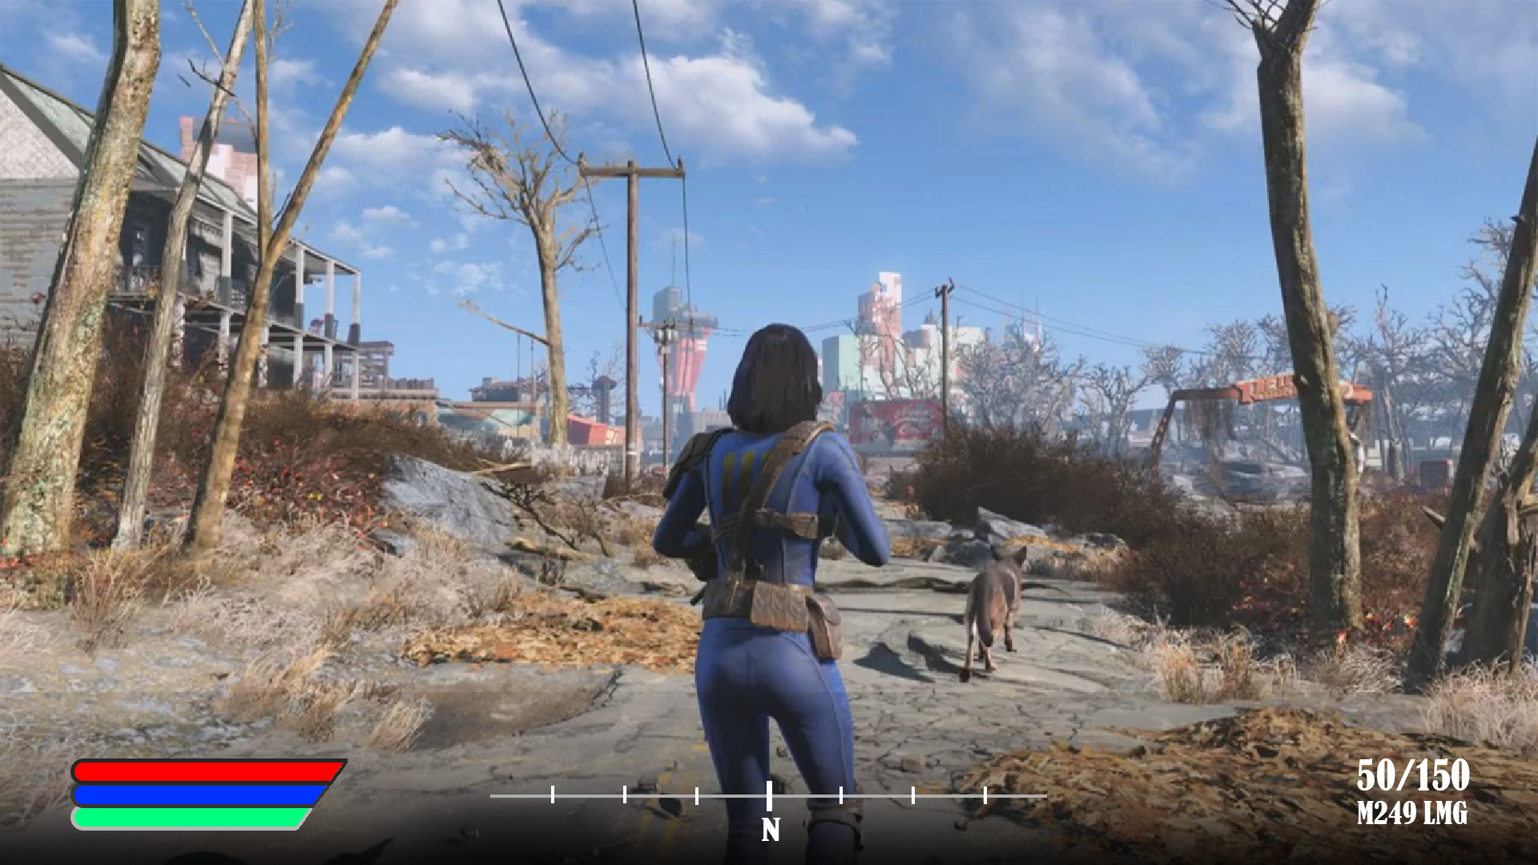
Heads Up Display(HUD) Draft
HUD is to be discrete and simple, not distracting the player from gameplay
This sketch is sized at
1920(l) x 1080(h) pixels
Health
Mana
Stamina
Ammo Count
*Image used is not representative of our game, it’s use is for demonstrational purposes only. Credits to Bethesda for creating Fallout 4, and for the base image.

Slide 9
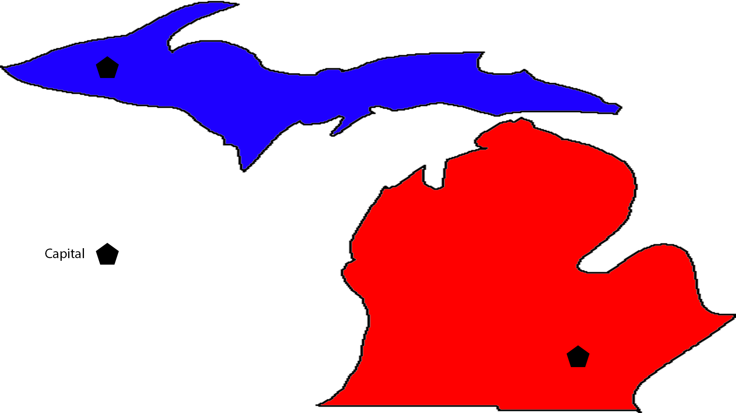
World Layout Draft

Slide 10
Production Schedule
Week 01 | Week 02 | Week 03 | Week 04 | Week 05 | Week 06 | Week 07 | Week 08 | Week 09
-NIL- | Game Concept, Game Design, Game Proposal | Setup Project, Framework | Base Open-world, Basic UI, Character movement | Projectile/ Melee Weapons, Projectiles | Transition to scenes (open-world improvement), Simple NPC patrol paths | NPC pathfinding, Basic Skill Trees for both factions | Expand Skill Trees, Basic Intro Quests | Expand Questline, Enemy NPCs
Week 10 | Week 11 | Week 12 | Week 13 | Week 14 | Week 15 | Week 16 | Week 17 | Week 18
Expand Questline (if needed), Items (potions, misc items), Usable Furniture | Polish UI and “feel” of movement and weapons | Playtesting, Fixing Bugs | Add analytics, Fixing Bugs | Polishing | Polishing | Final Presentation | Submission | -NIL-

Slide 11






Development Software
Visual Studios 2015
Unity 2017
Autodesk Maya
Adobe Photoshop
Adobe Audition/Ableton Live 10

